Slide 1

Introduction to OpenStreetMap
Notes:
Good afternoon, and kumusta everyone! Welcome to the mapathon!

Slide 2

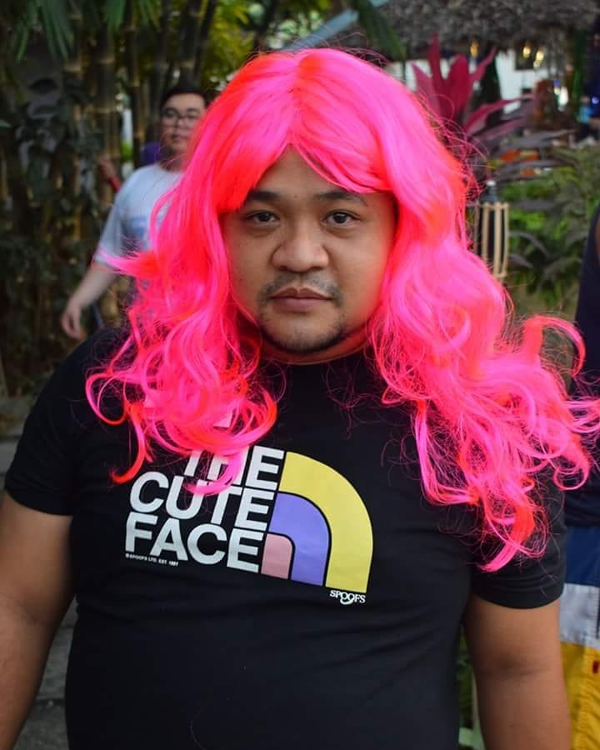



Hello!
I’m Mikko Tamura
Community Manager, Open Mapping Hub - Asia- Pacific
Volunteer, OSM-Philippines
mikko.tamura@hotosm.org
@mikkotamura
mikko_tamurae

Slide 3
Learning Objectives:
In this session, we aim to:
Gain an understanding about Openstreetmap (OSM)
Discover various uses cases or applications of OSM and its data
Identify one use case or application of OSM and its data in your local area or community (per intern)

Slide 4
PROGRAM
Time (CEST) | Duration (mins.) | Topic/Activity | Details | In-Charge
15:00 - 15:05 | 05 | Introduction | Opening
15:05 -15:20 | 15 | Introduction to OpenStreetMap, Missing Maps and Humanitarian OpenStreetMap Team | Introduction on OpenStreetMap, Using OSM for Humanitarian and Disaster Response | Chomba
15:20-15:30 | 10 | Introduction to Youthmappers | Introduction about YouthMappers, Benefits of being a Local Chapter, Chapter Application | Feye
15:30 -15:50 | 20 | Tutorial on how to map | Creating your mapping account, and Demo to mapping using the Tasking Manager / OSM iD editor | Chomba
15:50 - 16:20 | 40 | Mapathon and Q&A | Mapping Activity with Q&A | HOT & Participants
16:20 - 16:30 | 10 | Sharing of Mapathon experience and closing | Closing | HOT & Participants
Notes:
Brief overview of our Program today..

Slide 5
OPENSTREETMAP (OSM)
INTRODUCTION
“Wikipedia of maps.”
Crowd-sourced/ community project to map the whole world!
www.openstreetmap.org/
Notes:
Unlike Google maps, OpenStreetMap is free and open! - free and open source software, Free and open formats, and free and open content
You are free to share, create, and adapt.
AS LONG AS YOU
Attribute: You must attribute public use of the data. You must keep intact any notices on the original data.
Share-Alike: If you probably use any adapted version from the data, you must also offer that adapted data under the ODbL.
Keep open.
OSM in Africa video: https://vimeo.com/373837936

Slide 6
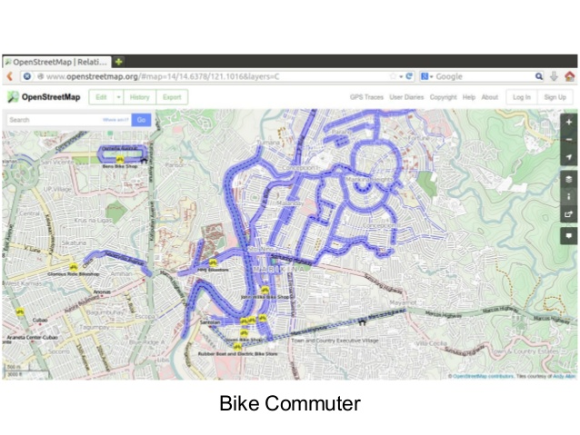
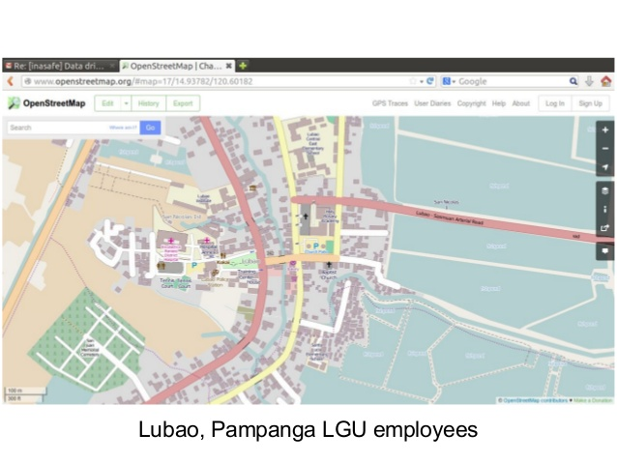
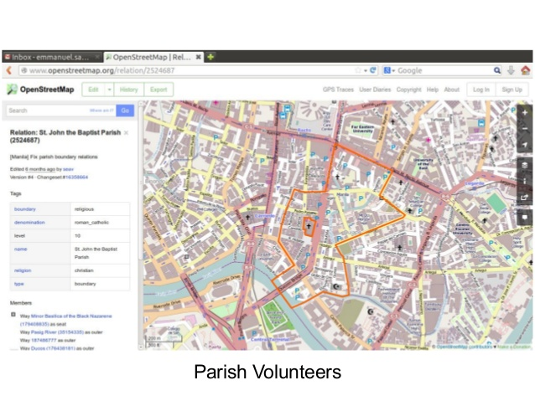
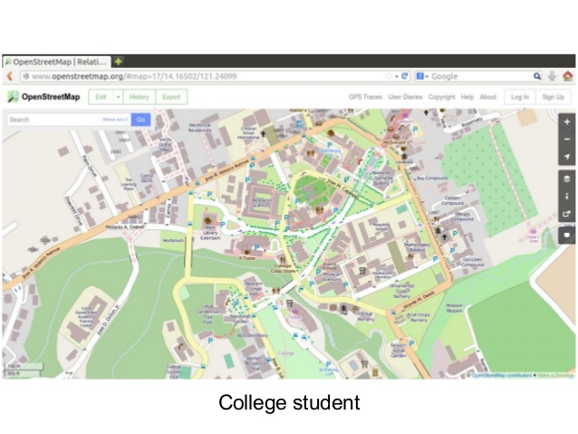
Who can contribute in OSM?
...us and many more!
Notes:
Now that we know OSM is free and open, who can contribute or map in OSM then?
These are just some examples of who are the contributors who mapped in OSM.

Slide 7
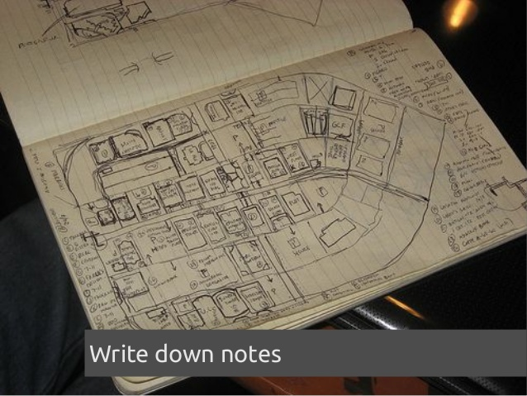
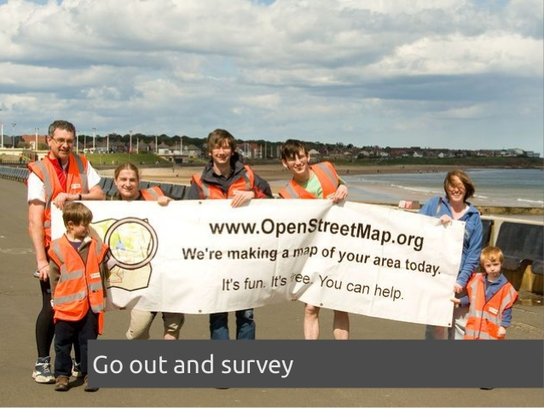
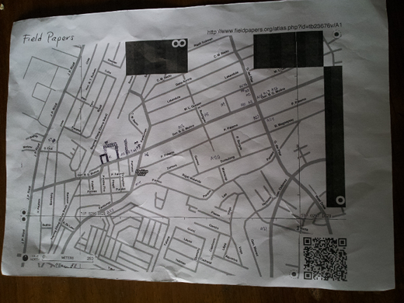
How to contribute in OSM?
fieldpapers.org
Notes:
field mapping + traditional/old school way

Slide 8

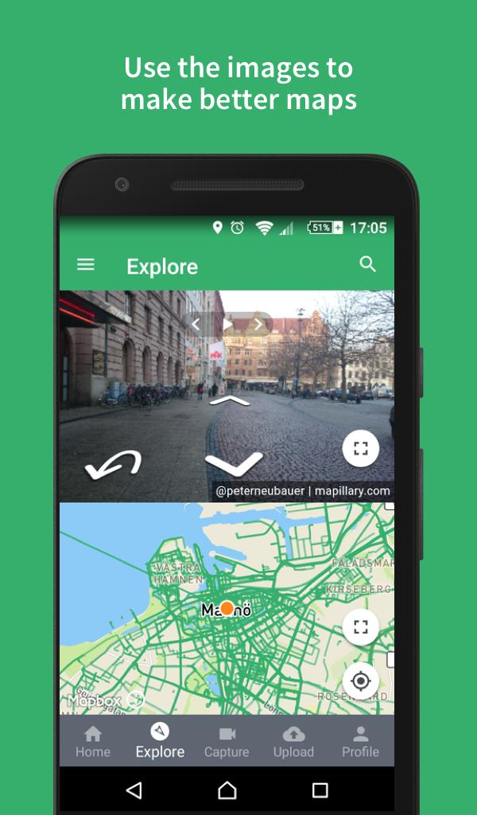
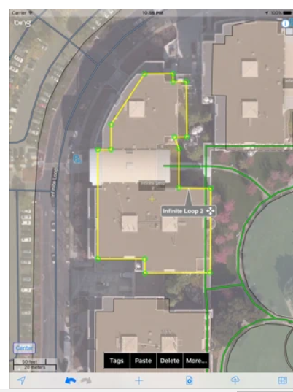
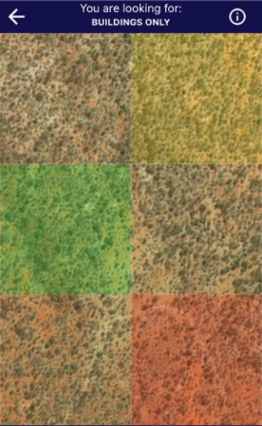
How to contribute in OSM?
MapSwipe
Mapillary
Go Map!!
Notes:
field mapping + using your phones!
Mapillary - take photos for street-level imagery while you’re on bike, walking or driving!
MapSwipe - tinder of maps!
Go Map!! - map using your phones!

Slide 9
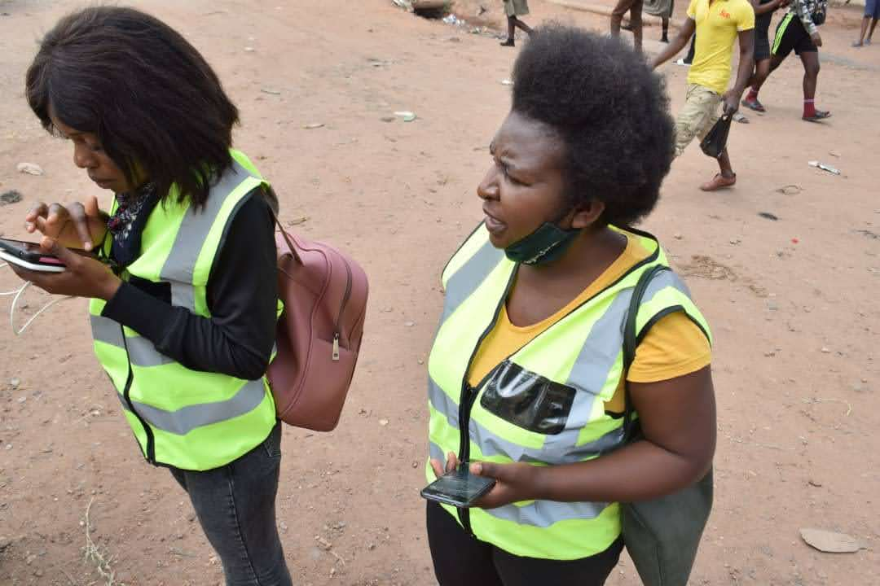
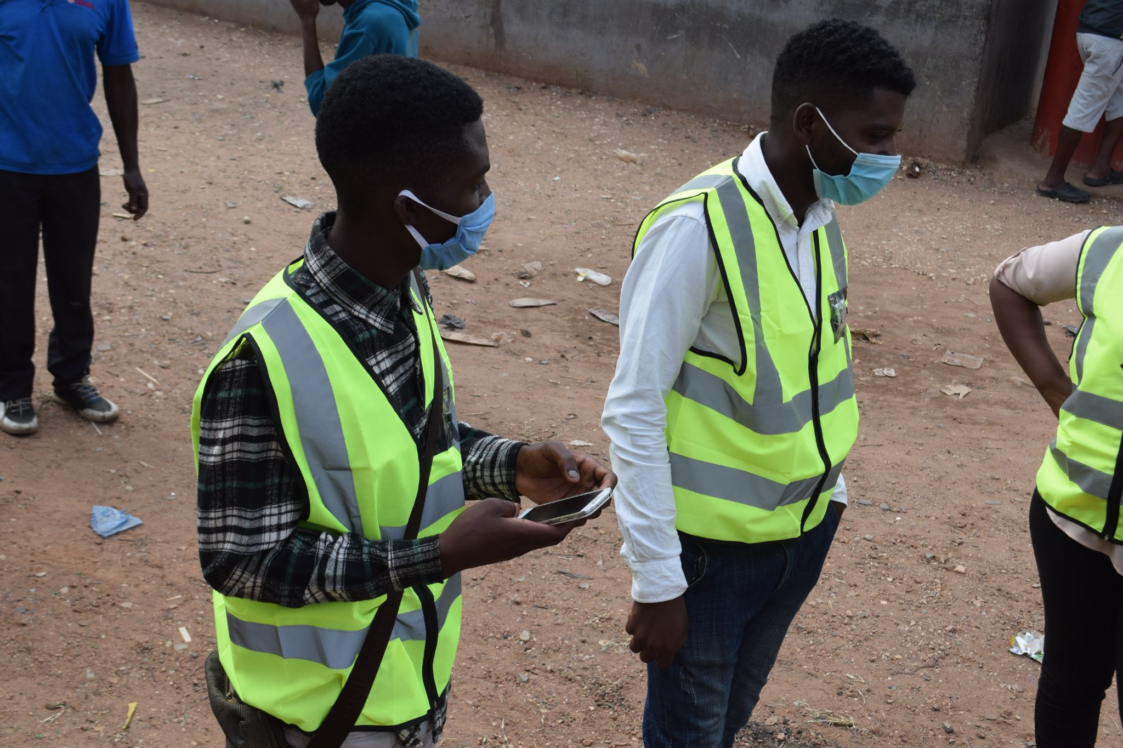
How to contribute in OSM?
Notes:
OR BOTH! field mapping using old school and mobile way!

Slide 10
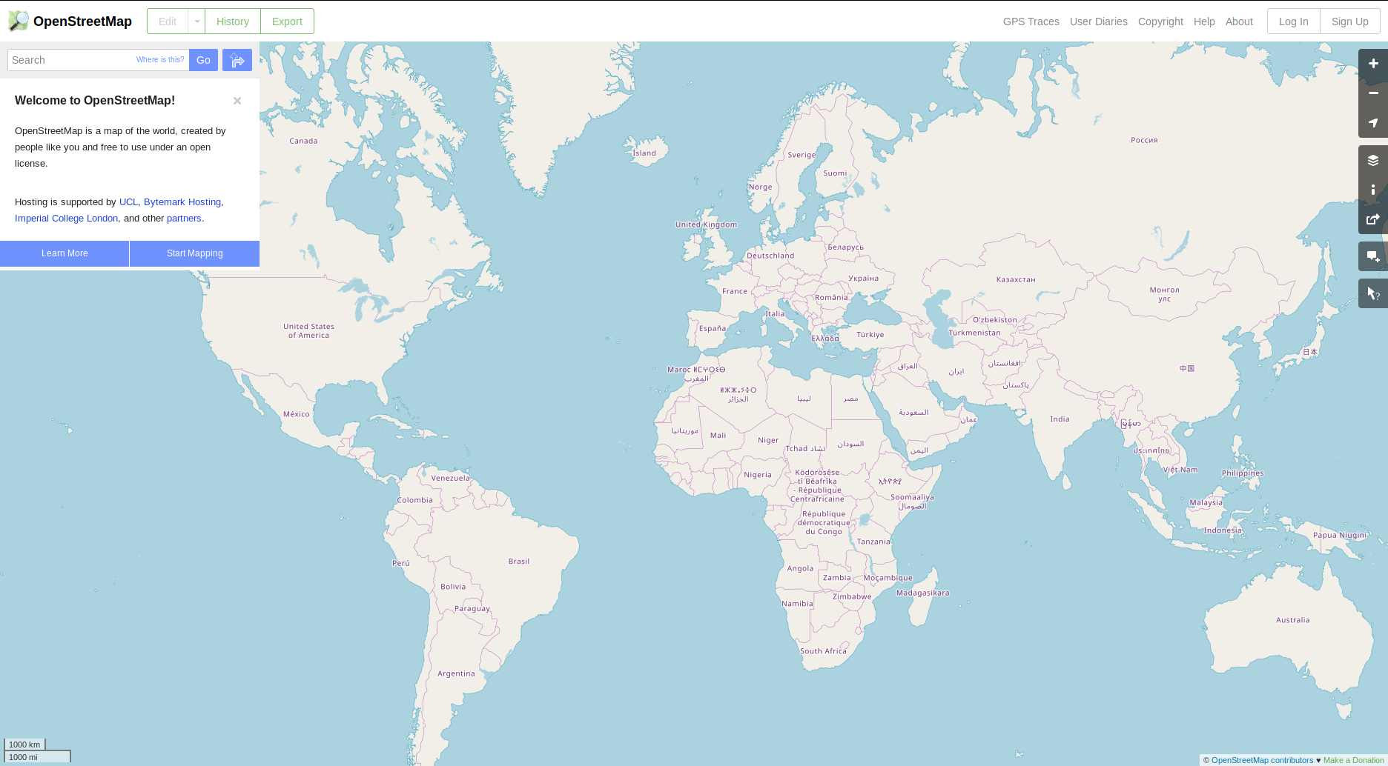
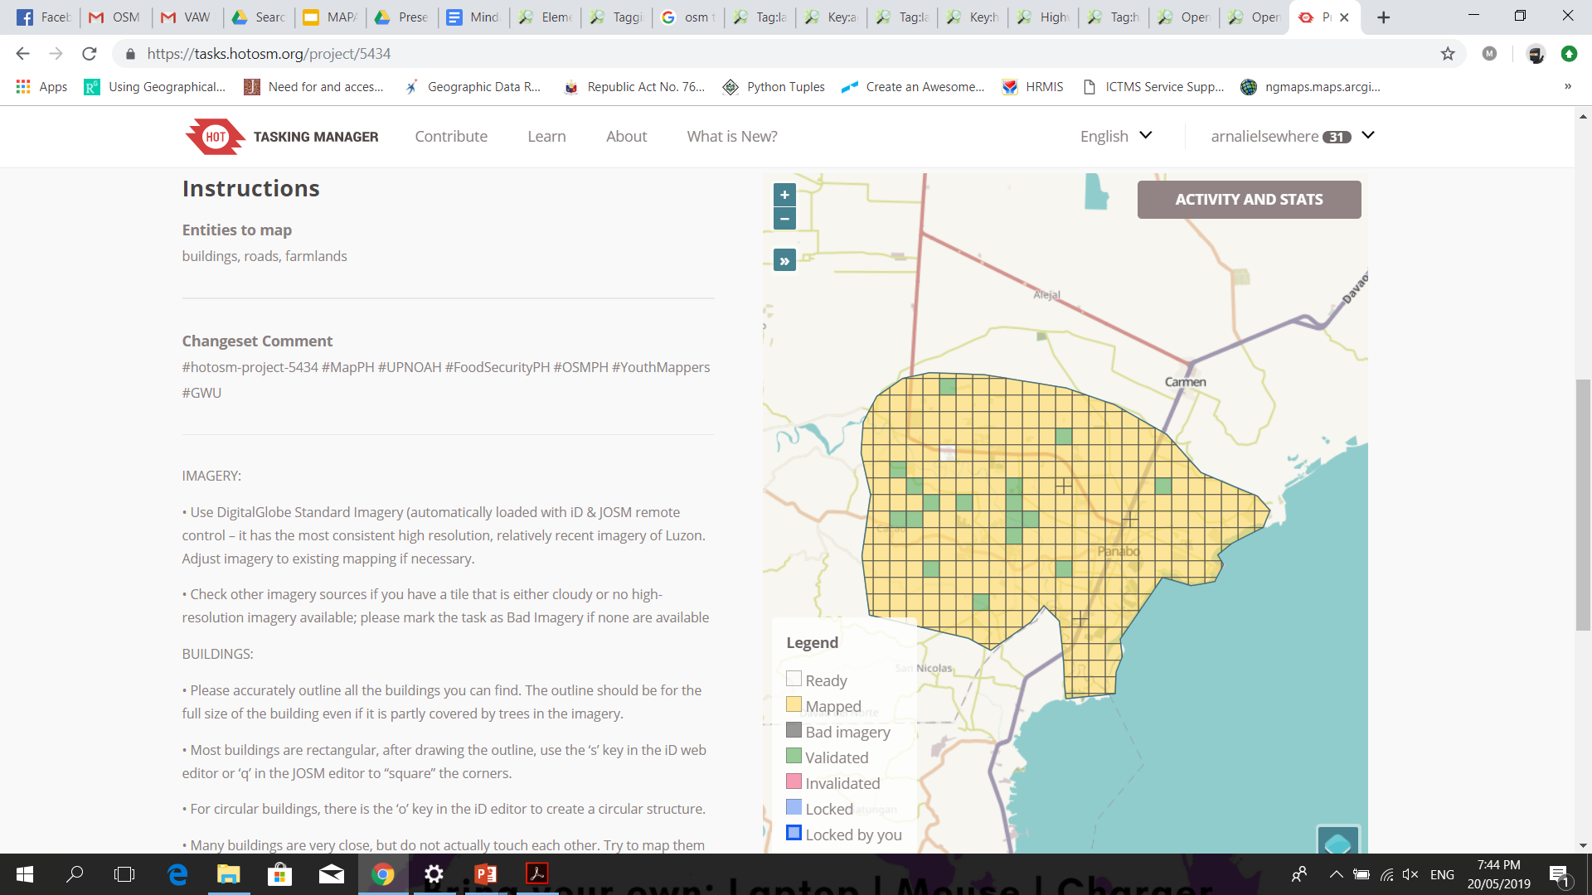
How to contribute in OSM?
HOT Tasking Manager
tasks.hotosm.org
OSM iD editor
openstreetmap.org
Notes:
Desktop and remote mapping
map in the comfort of you home! map from home!
Example of editors for OSM, widely used are…
OSM iD editor - default editor when you go to osm.org
HOT Tasking Manager - not really an editor, but it organizes editing by splitting a large area (of your project) into smaller areas or grids which are called tasks
We’ll learn mo about that later

Slide 11
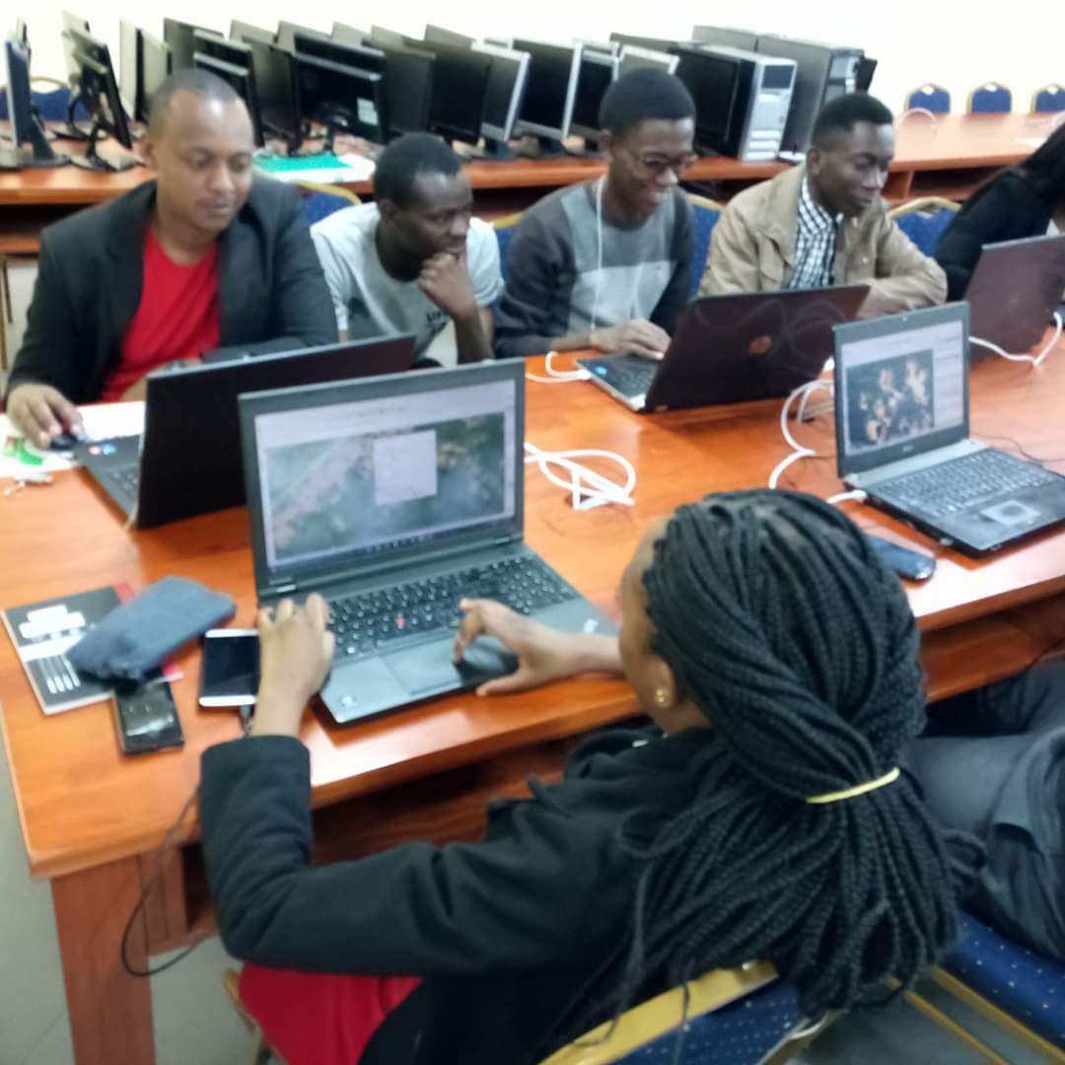
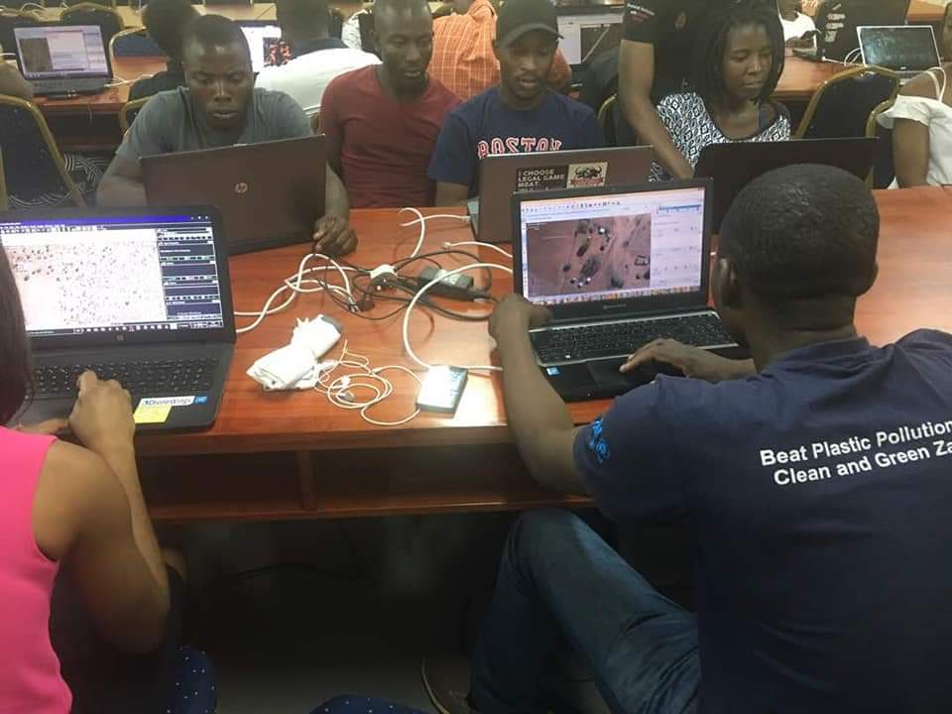
Mapathons x Mapping Party
Notes:
examples of mapping parties / mapathons (indoor/physical using virtual tools)

Slide 12
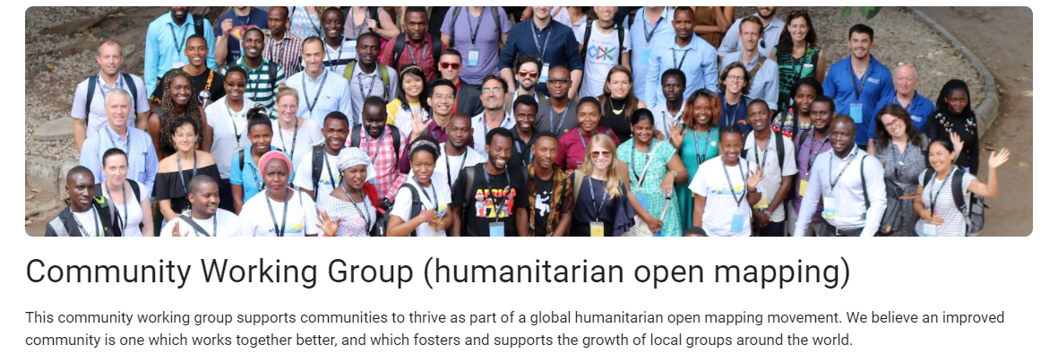
OSM is a community
(and a community of communities)
bit.ly/communitywg
Notes:
NOTE: OSM is a global community, and is a community of (small) communities.
There are communities per city, country or region, and also thematic communities like the Humanitarian Open Mapping Community WG
This community working group supports communities to thrive as part of a global humanitarian open mapping movement.
More info on the link: bit.ly/communitywg

Slide 13
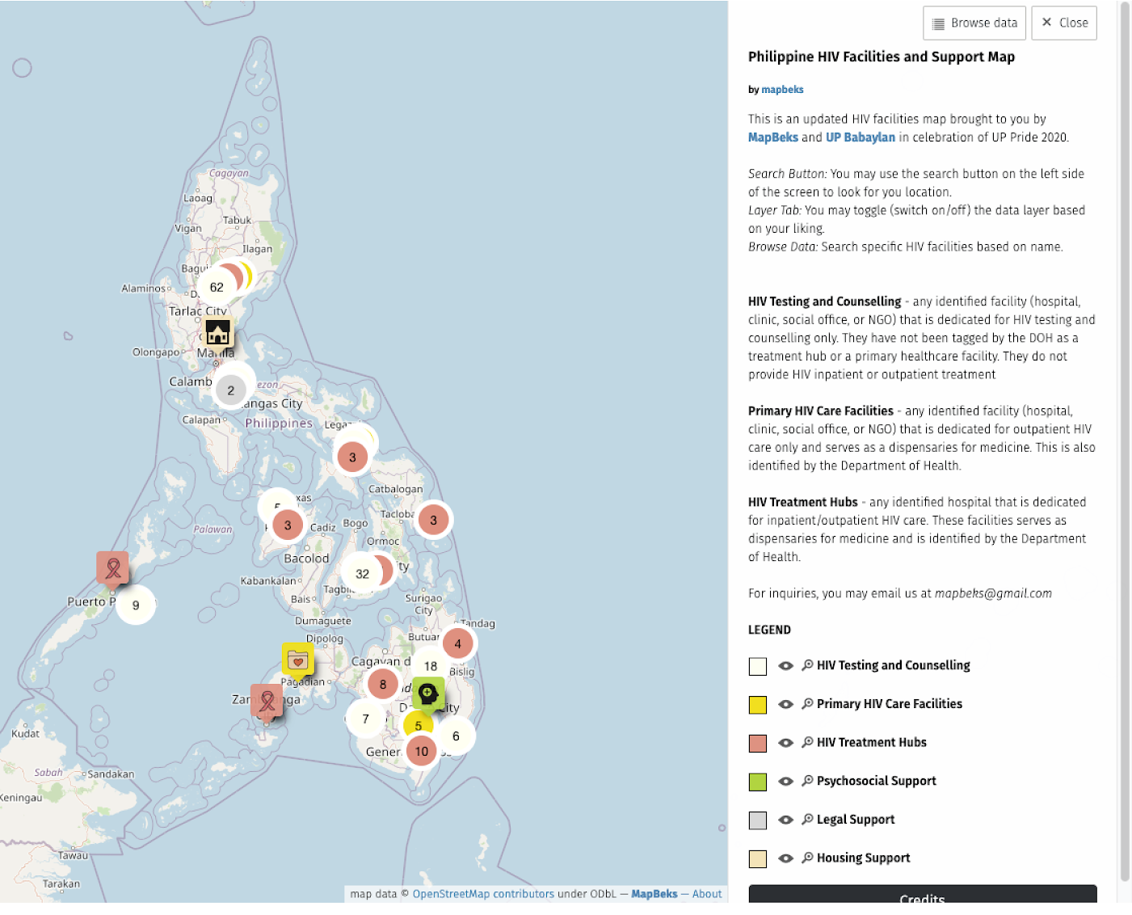
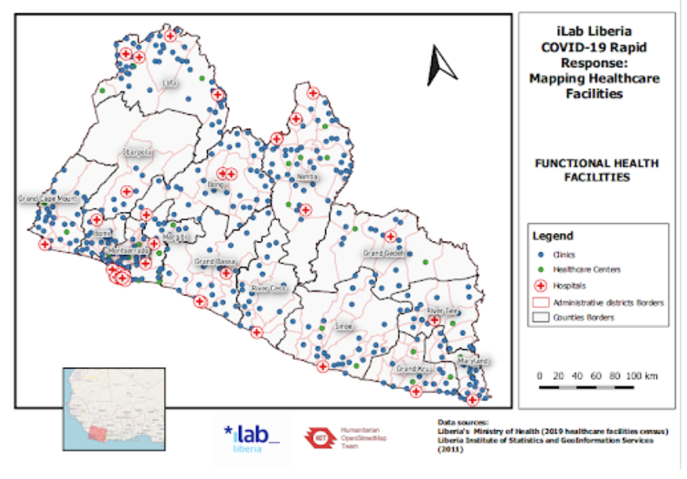
use cases of OSM
Notes:
Advocacy community mapping (individual, small groups)
Mapping HIV facilities, initiative by Mapbeks
iLab Liberia Covid 19 Response to map healthcare facilities
From Sophie (Microgrant case study: iLab Liberia): https://docs.google.com/presentation/d/19pdEBeEIrFY8wQoCGYtr6N6U26ud502BCBGhZBE6EyA/edit#slide=id.ga95f50e639_0_567
https://www.hotosm.org/updates/supporting-coronavirus-response-through-mapping-in-liberia/

Slide 14
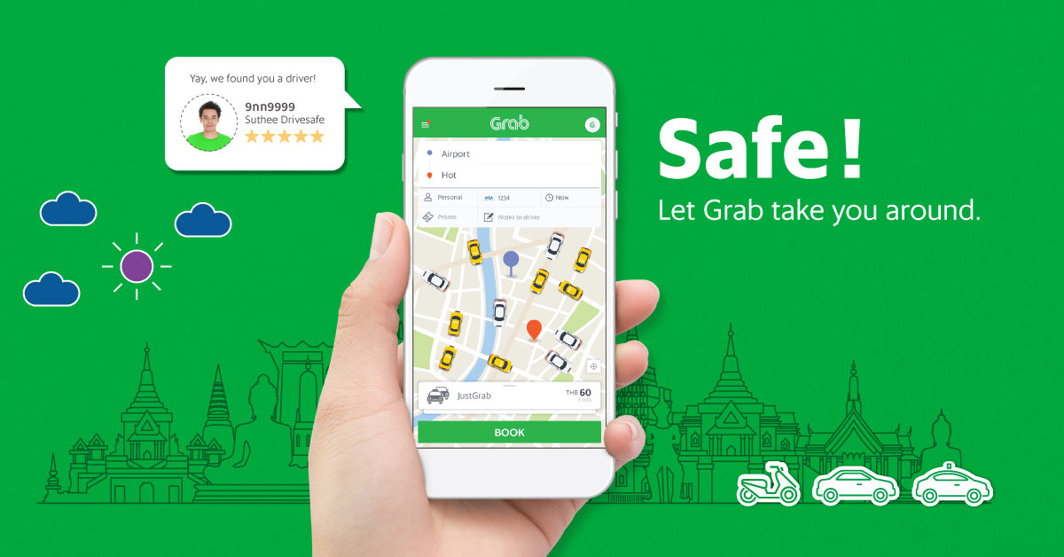
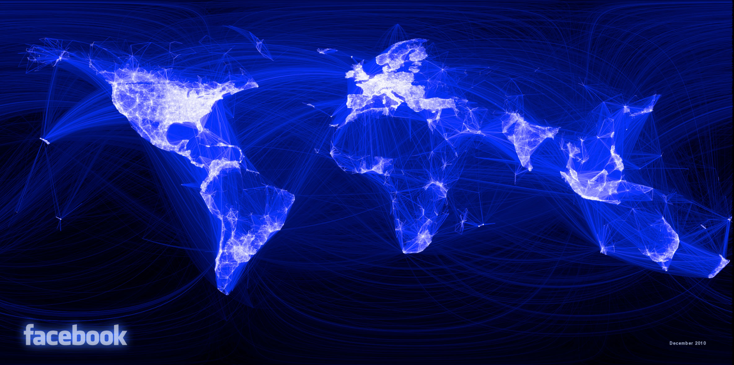
use cases of OSM
Notes:
private sector
eg Grab - ride-hailing app in SE Asia
it is like uber or lyft, for navigation and direction
Facebook - so people are connected? who knows how FB uses maps?

Slide 15

YOUTHMAPPERS
“We don’t just build maps. We build mappers.”
youthmappers.org/
Notes:
another usecase or community of OSM - Youthmappers
Youthmappers is an international consortium of university-level student mapping clubs, with local chapters in universities of various countries.
More info, if you would like to your university to sign up as a youthmapper: youthmappers.org

Slide 16
MISSING MAPS
INTRODUCTION
Notes:
another usecase of OSM and why contribute?
Around the world, natural disasters and humanitarian crises affect millions of individuals -- yet, in many of the areas where disasters occur, these individuals are quite literally ‘missing’ from the map. This makes it difficult for first responders to deliver life-saving aid and plan disaster relief efforts. Missing Maps was an effort established by Humanitarian OpenStreetMap Team (HOT - where I work), MSF (Doctors Without Borders), British Red Cross, and American Red Cross to create detailed digital maps of the world’s ‘unmapped’ places

Slide 17
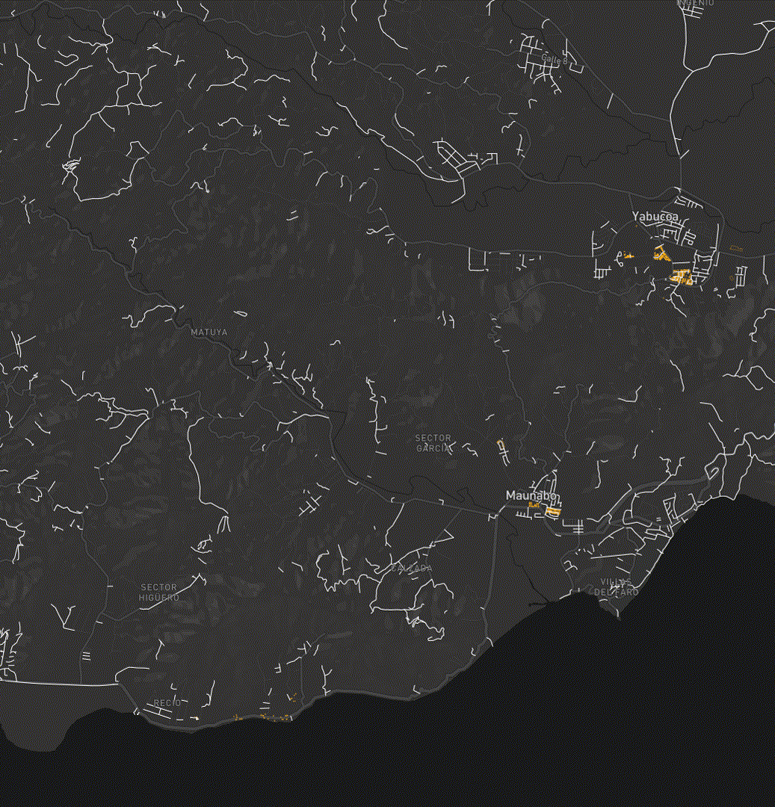
THE MISSING MAPS PROJECT
GOAL:
To map areas where people live at risk of disasters and crises
PROCESS:
Mapping: remote volunteers trace maps over satellite images
Remote Validation: by remote experienced mappers
Field Validation: local mapping, details e.g. place names, hospitals, are added
OUTCOME:
Individuals, communities and organizations can use the data and maps to better prepare and respond to disasters and crises
Puerto Rico 2017 - Hurricane Maria Mapping
Notes:
To put what we are doing today in context - The Missing Maps Project involves a 3 step process. Today, we’ll be conducting remote mapping, a first but crucial step in the process. It involves volunteers like yourselves looking closely at satellite imagery and adding or tracing features like buildings and roads.
Secondly, These maps are then checked by expert mappers we call validators. They will look closely at all the work you have done and either approve or fix it if necessary.
And then, These checked maps are then often printed / taken to the field and local volunteers add crucial details like street names, place names and the locations of health centres.
While you can rest assured that your edits will be checked before they are used in the field, any edits you make today will be uploaded straight onto OpenStreetMap, we therefore have a responsibility as editors to ensure that our map contributions are as accurate as possible in the first instance.

Slide 18
Exercise / Discussion
What do you think will be the use case or application of OSM and its data in your local area or community?
www.openstreetmap.org/

Slide 19
OPENSTREETMAP (OSM)
INTRODUCTION
Questions?
www.openstreetmap.org/

